Slide 1

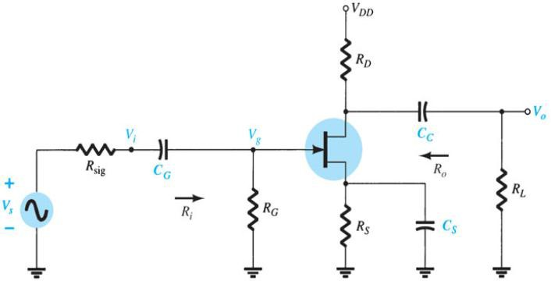

University of Diyala Engineering College
Department of Communications Engineering
Electronics II : 3^{ed} Year - 2015/2016 By: Hussein Ahmed Mahmood
Example (3): Determine the cutoff frequencies for the network of fig.3. using the following parameters : C_{S} = 2µf , C_{G} = 0.01µf , C_{C} = 0.5µf , R_{Sig} = 10kΩ, R_{G} = 1MΩ , R_{D} = 4.7kΩ , R_{S} = 1kΩ , R_{L} = 2.2kΩ , I_{DSS} = 8mA , V_{d} = -4v , r_{d} = ∞Ω, V_{DD} =20v,V_{GSQ} = -2v?
Solution: The dc base voltage is determined by:
| |
( )
(
)
Fig.3
( )
For C_{G}
( ) ( )( )( )
For C_{c}
( ) ( )( )( )

Slide 2
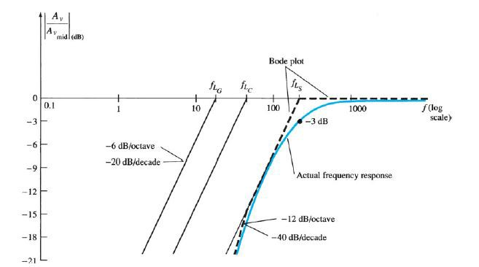
University of Diyala Engineering College
Department of Communications Engineering
Electronics II : 3^{ed} Year - 2015/2016 By: Hussein Ahmed Mahmood
For C_{S}
‖ ‖
( )( )( )
Because f_{LS} is the largest of the three cutoff frequencies, it defines the low-cutoff frequency for the network of Fig.3.
The Midband Gain of the system is determined by:
( ) ( )( )
( )( )

Slide 3
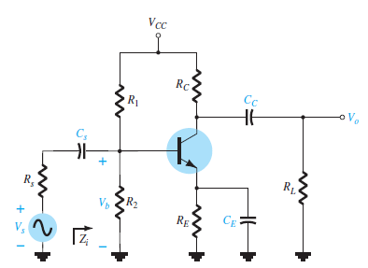

University of Diyala Engineering College
Department of Communications Engineering
Electronics II : 3^{ed} Year - 2015/2016 By: Hussein Ahmed Mahmood
Example (4): Determine the high-cutoff frequencies for the network of fig.4. using the following parameters : C_{S} = 10µf , C_{E} = 20µf , C_{C} = 1µf , R_{S} = 1kΩ, R₁ = 40kΩ
, R₂ = 10kΩ , R_{E} = 2kΩ , R_{C} = 4kΩ , R_{L} = 2.2kΩ , β = 100 , V_{CC} = 20v , r_{o} = ∞Ω,
C_{be} = 36pf, C_{bc} = 4pf, C_{ce} = 1pf, C_{Wi} = 6pf, C_{Wo} = 8pf ?
Solution: The dc base voltage is determined by:
( )
( )
The Midband Gain of the system is determined by:
Fig.4
( ) ( )
With C_{i} = C_{wi} + C_{be} + C_{Mi} , C_{Mi} = ( 1- A_{v}) C_{bc} C_{i} = C_{wi} + C_{be} + ( 1- A_{v}) C_{bc}
= 6pf + 36pf + [ 1 - (-90)] 4pf
= 406pf
20

Slide 4
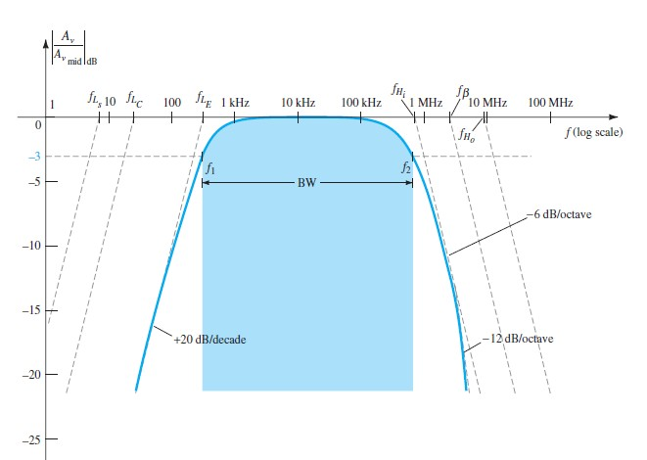
University of Diyala Engineering College
Department of Communications Engineering
Electronics II : 3^{ed} Year - 2015/2016 By: Hussein Ahmed Mahmood
( )( )( )
With C_{o} = C_{wo} + C_{ce} + C_{Mo} , C_{Mo} = ( 1- 1/A_{v}) C_{bc} C_{o} = C_{wo} + C_{ce} + ( 1- 1/A_{v}) C_{bc}
= 8pf + 1pf + [ 1- 1/(-90)] 4pf
= 13.04pf
( )( )( )

Slide 5
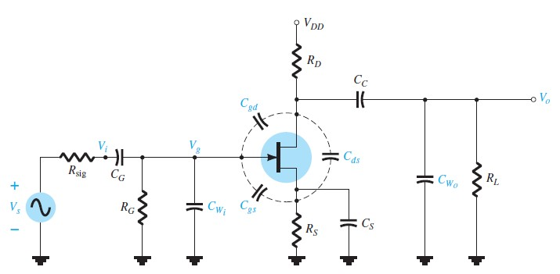
University of Diyala Engineering College
Department of Communications Engineering
Electronics II : 3^{ed} Year - 2015/2016 By: Hussein Ahmed Mahmood
Example (5): Determine the high-cutoff frequencies for the network of fig.5. using the following parameters : C_{S} = 2µf , C_{G} = 0.01µf , C_{C} = 0.5µf , R_{Sig} = 10kΩ, R_{G} = 1MΩ , R_{D} = 4.7kΩ , R_{S} = 1kΩ , R_{L} = 2.2kΩ , I_{DSS} = 8mA , V_{d} = -4v ,
r_{d} = ∞Ω, V_{DD} =20v,V_{GSQ} = -2v, C_{gd} = 2pf, C_{gs} = 4pf, C_{ds} = 0.5pf, C_{Wi} = 5pf, C_{Wo} = 6pf ?
Solution: The dc base voltage is determined by:
| |
( )
(
)
( )
The Midband Gain of the system is determined by:
Fig.5
( ) ( )( )
( )( )
With C_{i} = C_{wi} + C_{gs} + C_{Mi} , C_{Mi} = ( 1- A_{v}) C_{gd} C_{i} = C_{wi} + C_{gs} + ( 1- A_{v}) C_{gd}
= 5pf + 4pf + ( 1+ 3) 2pf
= 9pf + 8pf = 17pf

Slide 6
University of Diyala Engineering College
Department of Communications Engineering
Electronics II : 3^{ed} Year - 2015/2016 By: Hussein Ahmed Mahmood
( )( )( )
With C_{o} = C_{wo} + C_{ds} + C_{Mo} , C_{Mo} = ( 1- 1/A_{v}) C_{gd} C_{o} = C_{wo} + C_{ds} + ( 1- 1/A_{v}) C_{gd}
= 6pf + 0.5pf + [ 1 – 1/ (-3) ] 2pf
= 9.17pf
( )( )( )

Slide 7
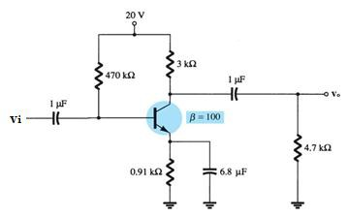

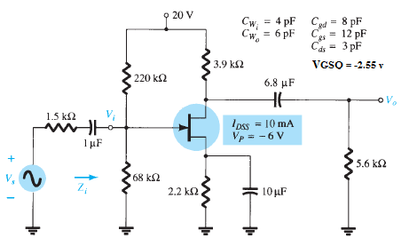
University of Diyala Engineering College
Department of Communications Engineering
Electronics II : 3^{ed} Year - 2015/2016 By: Hussein Ahmed Mahmood
H.W :- For the network of Fig .1. determine : a - r_{e} .
b - A_{vmid} = V_{o} / V_{i} .
c - Z_{i} .
d - f_{LS} , f_{LC} , f_{LE} .
e – Sketch the low- frequency response for the amplifier .
Fig .1
H.W :- For the network of Fig .2. determine : a – g_{mo} and g_{m} .
b – A_{v} and A_{vs}.
c – f_{Hi} and f_{Ho} .
d - Sketch the high- frequency response for the amplifier .
Fig .2

